Slide 1
Genetic algorithms Problem #5

Slide 2
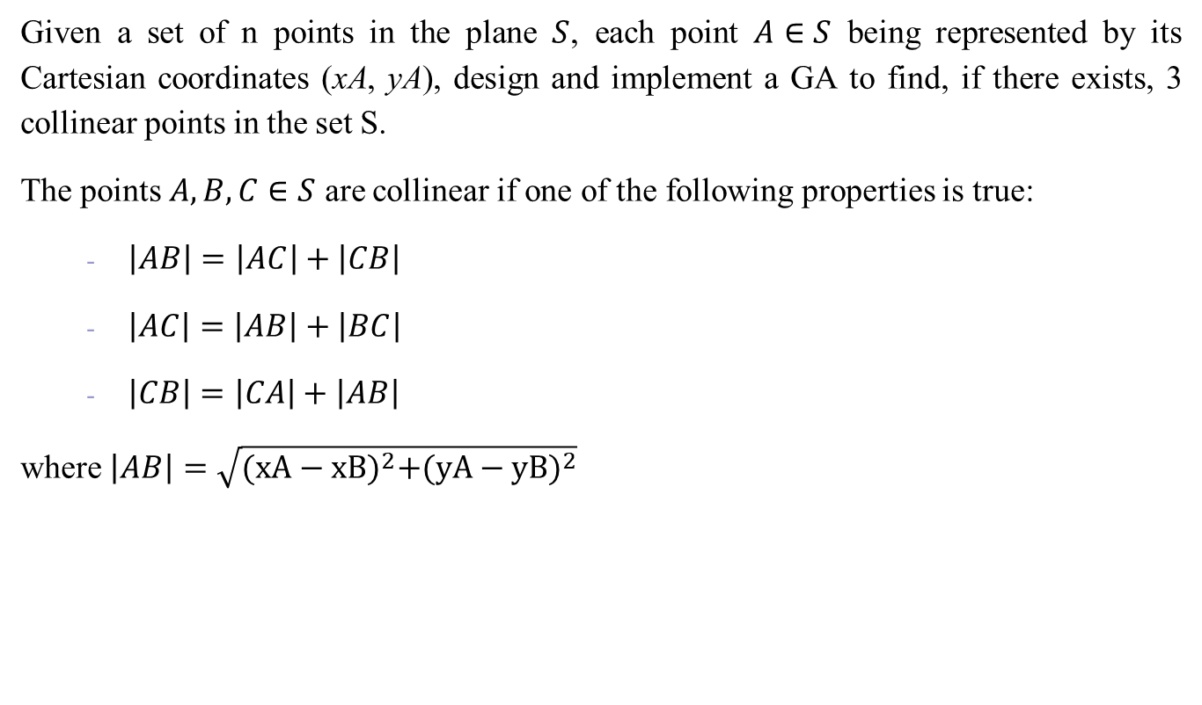
I. Problem statement
Given a set of n points in the plane $S$, each point $A∈S$ being represented by its Cartesian coordinates (xA, yA), design and implement a GA to find, if there exists, 3 collinear points in the set S.
The points $A,B,C∈S$ are collinear if one of the following properties is true:
$\left|AB\right|=\left|AC\right|+\left|CB\right|$
$\left|AC\right|=\left|AB\right|+\left|BC\right|$
$\left|CB\right|=\left|CA\right|+\left|AB\right|$
where $\left|AB\right|=\sqrt{{(xA−xB)}^{2}+{(yA−yB)}^{2}}$

Slide 3

I. Problem statement
Example: S = the set of points
$S=\left(\begin{aligned}\begin{matrix}−10 & 3 \\ −98 & 10 \\ 1 & 1\end{matrix} \\ \begin{matrix}5 & 9 \\ 20 & 20 \\ 89 & 87\end{matrix} \\ \begin{matrix}15 & 29 \\ 20 & 30 \\ 87 & 87\end{matrix}\end{aligned}\right)$
3 distinct collinear points

Slide 4
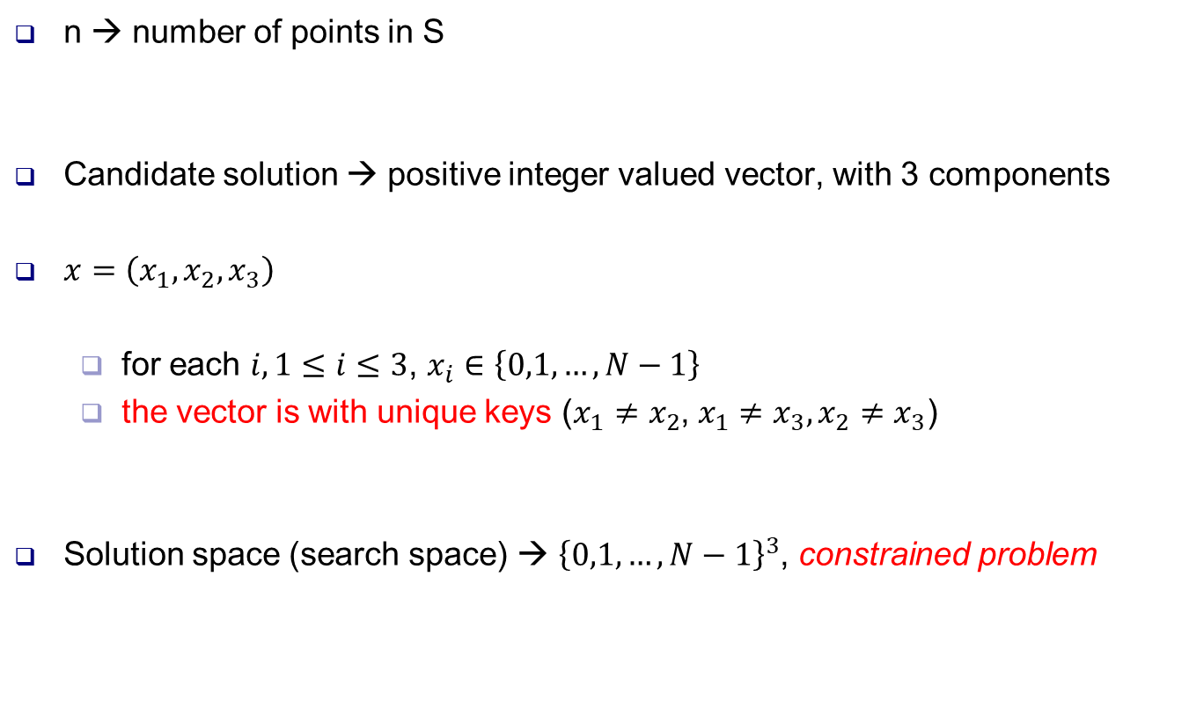
II. Genotype representation
n → number of points in S
Candidate solution → positive integer valued vector, with 3 components
$x=\left(x_{1},x_{2},x_{3}\right)$
for each $i,1≤i≤3$, $x_{i}∈\left\{0,1,…,N−1\right\}$
the vector is with unique keys ($x_{1}≠x_{2}$, $x_{1}≠x_{3},x_{2}≠x_{3}$)
Solution space (search space) → ${\left\{0,1,…,N−1\right\}}^{3}$, constrained problem

Slide 5

II. Genotype representation
Example
$$S=\left(\begin{aligned}\begin{matrix}−10 & 3 \\ −98 & 10 \\ 1 & 1\end{matrix} \\ \begin{matrix}5 & 9 \\ 20 & 20 \\ 89 & 87\end{matrix} \\ \begin{matrix}15 & 29 \\ 20 & 30 \\ 87 & 87\end{matrix}\end{aligned}\right)⟺\left(\begin{aligned}0 \\ 1 \\ 2 \\ 3 \\ 4 \\ 5 \\ 6 \\ 7 \\ 8\end{aligned}\right)$$
$$x=\left(4,2,5\right)⟺\left\{\begin{aligned}A=\left(20,20\right)=S\left[4\right] \\ B=\left(−98,10\right)=S[2] \\ C=\left(89,87\right)=S[5]\end{aligned}\right.$$
THE 5TH ROW IN S

Slide 6
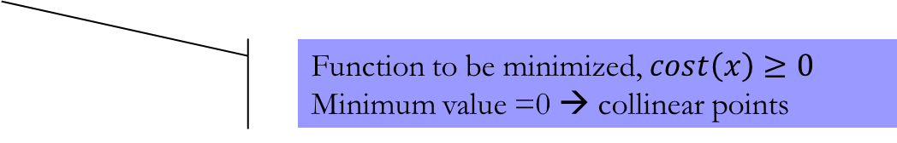

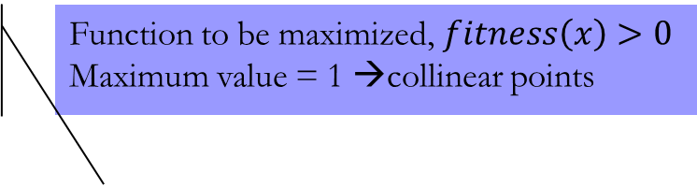
III. Fitness function
$x=\left(x_{1},x_{2},x_{3}\right)$ genotype → $A=S[x_{1}$], $B=S[x_{2}$], $C=S[x_{3}$]
$$cost\left(x\right)=min\left\{\left|AC\right|+\left|CB\right|−\left|AB\right|,\left|AB\right|+\left|BC\right|−\left|AC\right|,\left|CA\right|+\left|AB\right|−\left|CB\right|\right\}$$
$$fitness\left(x\right)=\frac{1}{1+cost\left(x\right)}$$
Function to be minimized, $cost\left(x\right)≥0$
Minimum value =0 → collinear points
Function to be maximized, $fitness\left(x\right)>0$
Maximum value = 1 →collinear points

Slide 7
IV. Population model
Generational model
Fix-sized populations
dim = the population size
The initial population – randomly generated

Slide 8
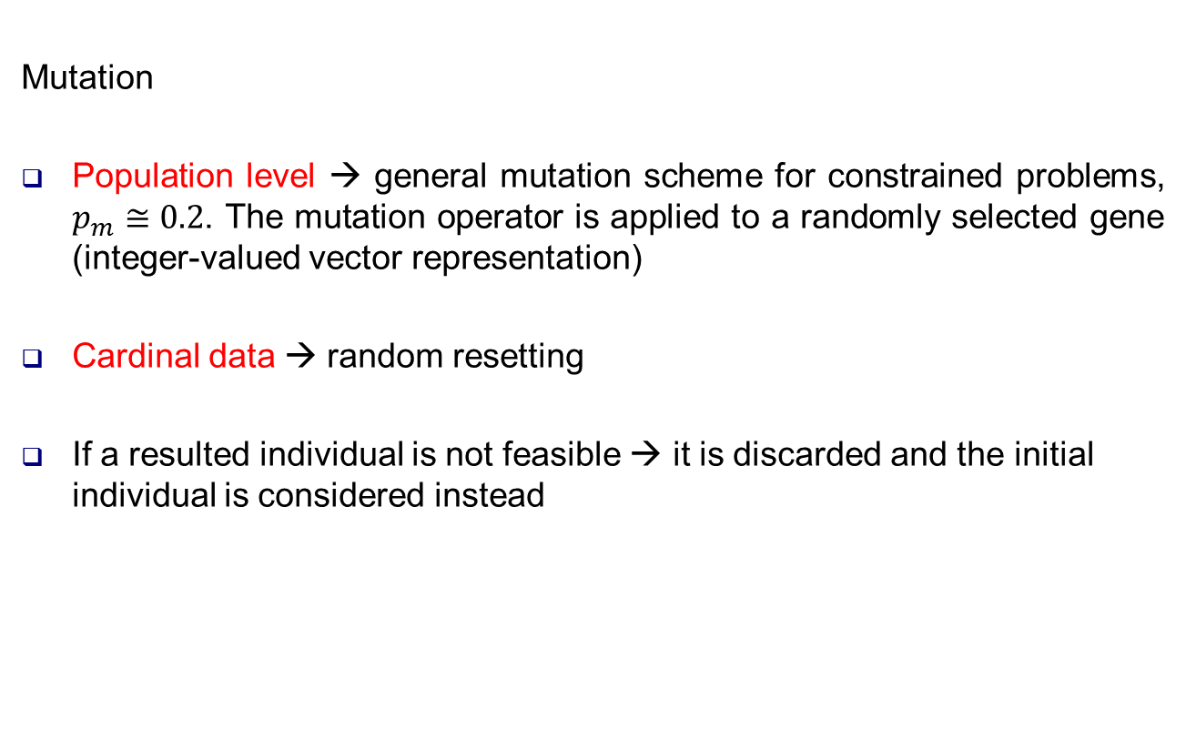
V. Variation operators
Mutation
Population level → general mutation scheme for constrained problems, $p_{m}≅0.2$. The mutation operator is applied to a randomly selected gene (integer-valued vector representation)
Cardinal data → random resetting
If a resulted individual is not feasible → it is discarded and the initial individual is considered instead

Slide 9
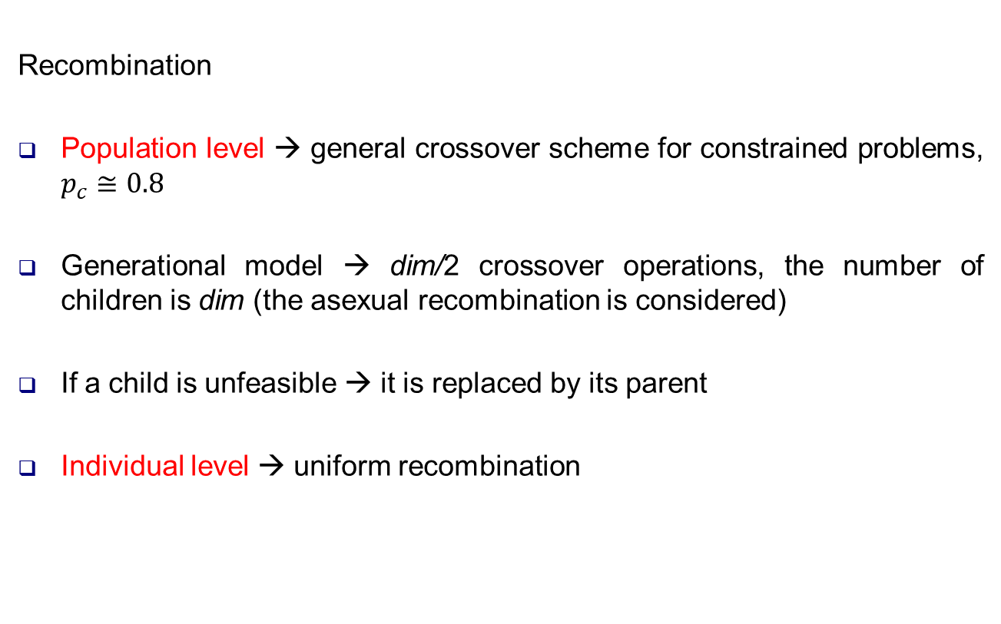
V. Variation operators
Recombination
Population level → general crossover scheme for constrained problems, $p_{c}≅0.8$
Generational model → dim/2 crossover operations, the number of children is dim (the asexual recombination is considered)
If a child is unfeasible → it is replaced by its parent
Individual level → uniform recombination

Slide 10
VI. Parent selection. Survivor selection
Mating pool selection
Generational model → given dim sized population, one should select dim parents
The fitness function is positive → one can use sigma scaling FPS
The sampling is implemented by the roulette wheel mechanism
Survivor selection (replacement)
Generational model → elitism

Slide 11
VII. Termination criterion
The search is over
after NMAX evolutionary cycles OR
if the diversity degree is 0 (computed in terms of fitness values) OR
the best fitness is around 1 (>0.999999)
The computed solution → the fittest individual from the last generation

Slide 12
VIII. Homework
The search space size is of polynomial type
Use the steady state model to solve the problem

